Slide 1
Welcome to Wings for Autism® Our Trip to the Airport Practice Guide

Slide 2
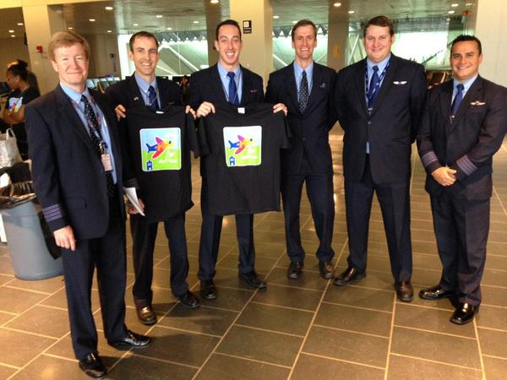
How to use the Trip to the Airport Practice Guide
This guide is for you to use as you prepare for your Wings for Autism event
It details what you can expect to experience at the airport
We invite you to personalize this guide:
Add your own photos and advice
Delete photos or advice you don’t need
And use this guide to prepare for your next, real trip

Slide 3
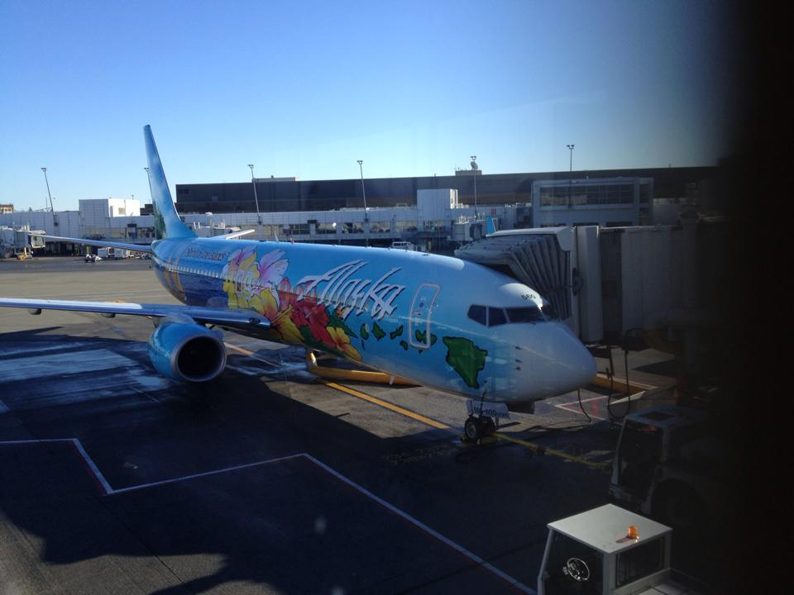
A lot of people travel by airplane
To visit family
To visit friends
To go on vacation
To go to meetings
To go to school

Slide 4
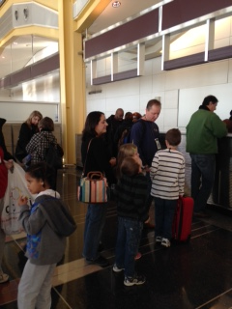
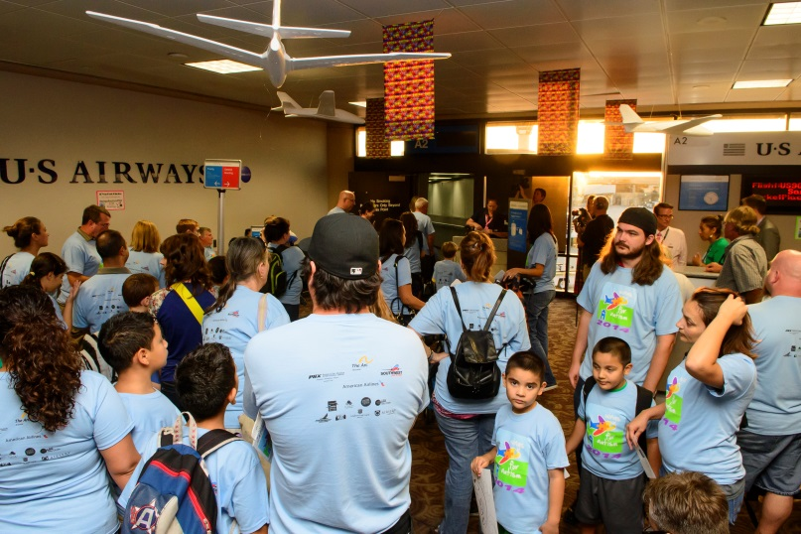
But airports can be crowded and noisy
A lot of people
A lot of loud announcements
Unfamiliar sights, sounds and smells
A lot of lines and waiting

Slide 5
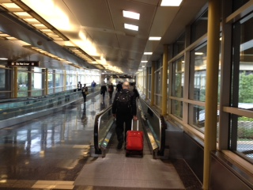
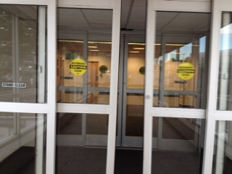
And airports have things we may not be familiar with
Escalators
Elevators
Moving sidewalks
Long hallways
Automatic doors

Slide 6
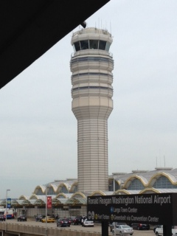
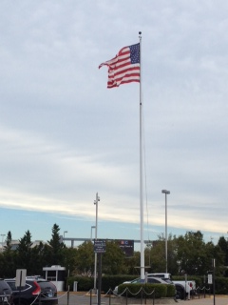
So we’re going to the airport to get used to the sights and sounds
We’re not going to fly on an airplane today. We will just move around on the ground while inside it.
We can go as slowly as we want.
We can stop and take breaks when we need them.
We can stop and go home at any time.

Slide 7
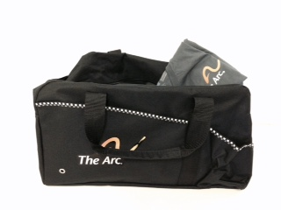
First we’ll decide what to take to the airport
Do we want to pack toys, games, snacks or other things in our carry-on luggage?
We can use these things while we wait to board our plane
We can use these things while we’re seated on the plane
We don’t have to pack anything if we don’t want to

Slide 8
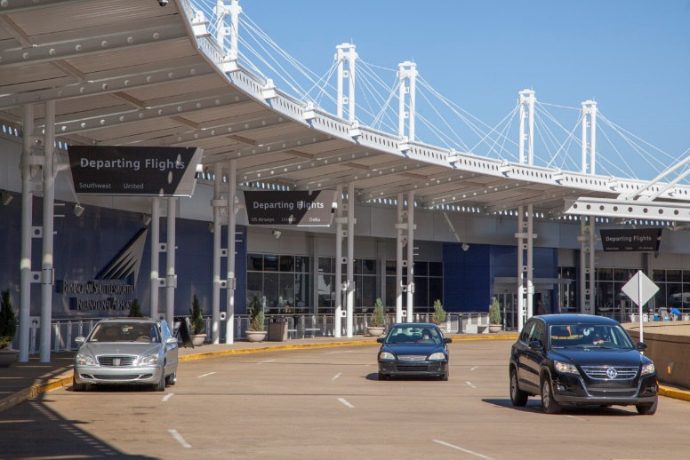
And travel to the airport
There’s lots of ways people get to the airport:
Car
Taxi or shuttle
Bus
Train
How will we travel to the airport?

Slide 9
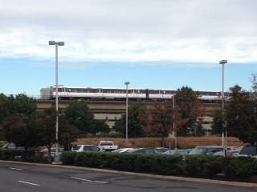
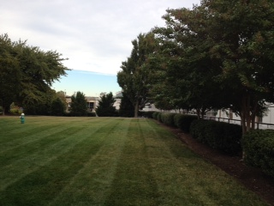
If we drive we’ll park the car
If we travel by car we’ll park it in a parking lot
Then we’ll walk/roll to the terminal
On our way we may see wide open spaces so we’ll need to stay close to each other

Slide 10
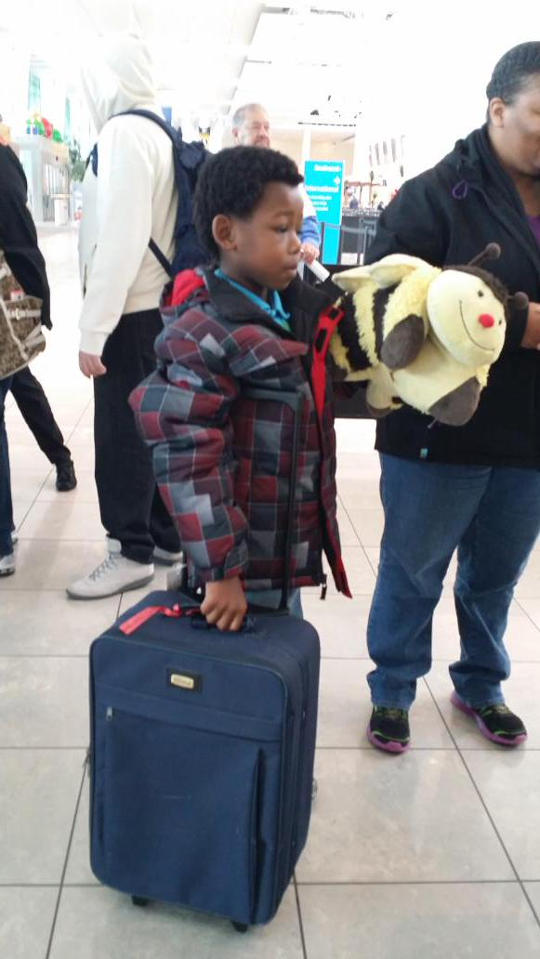
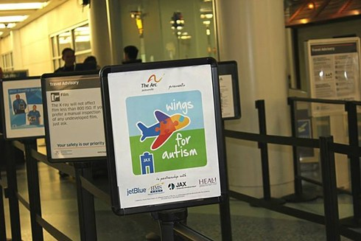
Then we’ll walk/roll to the terminal
We’ll follow the Wings for Autism® signs to the Ticket Counter
Our walk/roll may be short or long
The airport may be noisy and crowded
We can take our time and rest if we want to

Slide 11
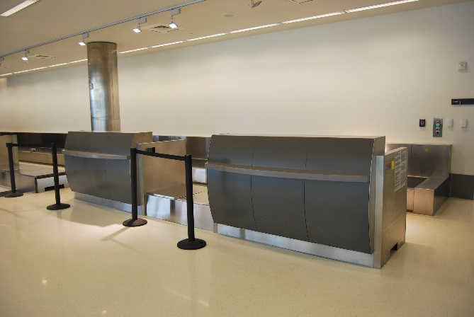
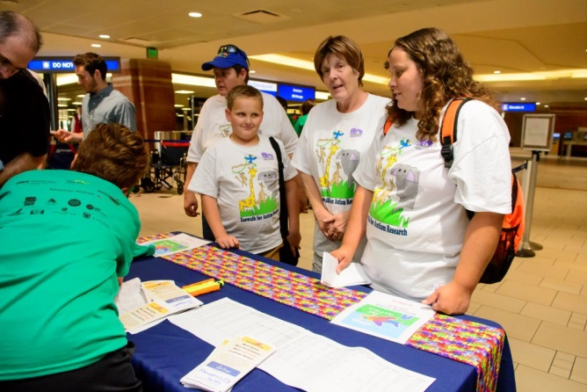
Our next step is to go the airline ticket counter
There will probably be a line and if there is we’ll have to wait our turn
Give the person our name
Listen to their instructions
Ask any questions we may have
We’ll provide a government-issued identification for people age 18 and over

Slide 12
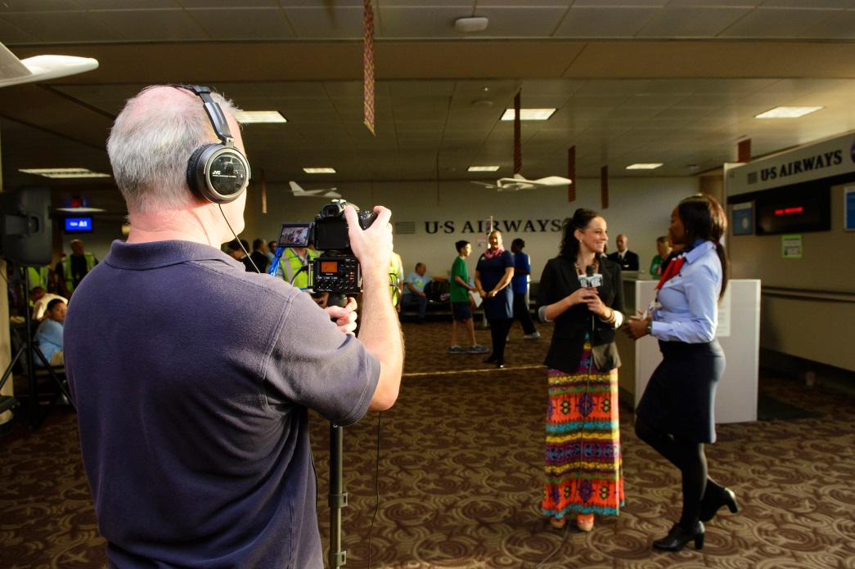
We may be asked if we’ll give permission for people to take out picture
We can say yes or no
The photos will be used by The Arc to describe the Wings program to families, airports and airlines
All of the pictures we’re looking at now are from people who said “Yes, you can use my photo”
How do you feel about our photo being taken?

Slide 13
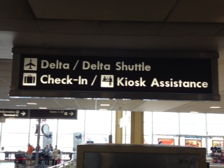
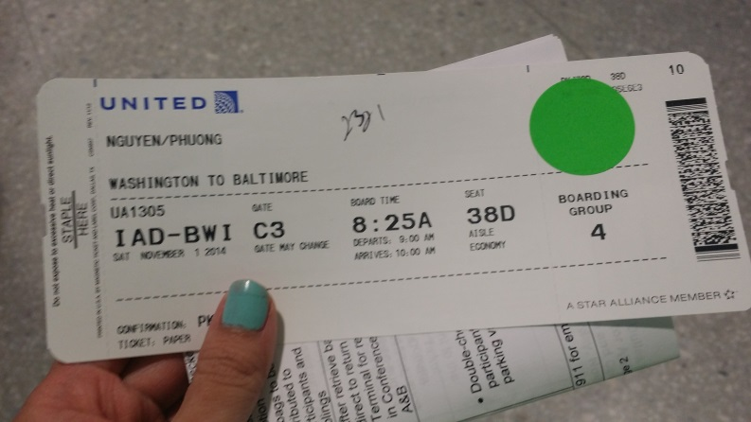
Then we’ll get our boarding pass
We’ll need the boarding pass to go through security
We’ll need the boarding pass to get on the plane
Where is a safe place we can keep our boarding pass so we don’t lose it?

Slide 14
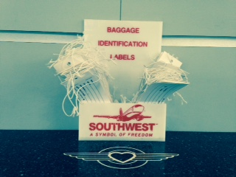
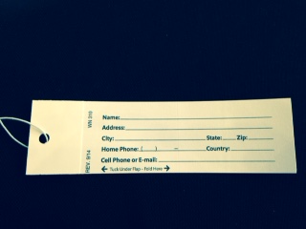
We’ll make sure we have an address tag
If we don’t have an address tag on our luggage we can get one from the ticket counter
We’ll fill it out
And attach it to our bag

Slide 15
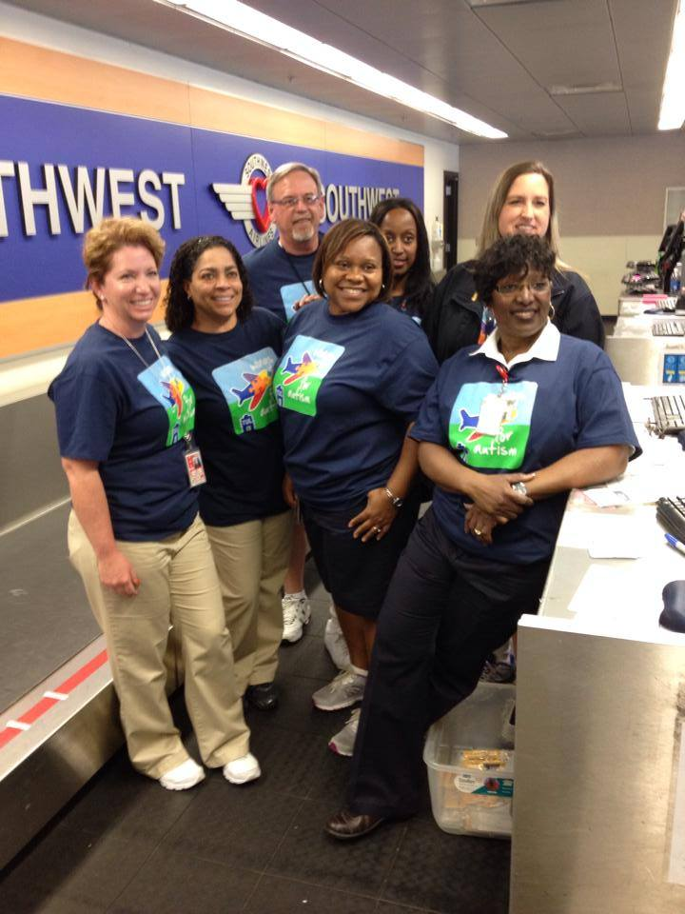
If we want we can take lots of pictures to remember today’s experience
Photos of the airport and their employees
Photos of the plane and airline employees
Photos of us!
We can add the photos to this guide and use them on our next, real trip

Slide 16
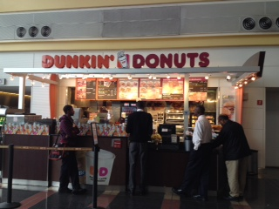
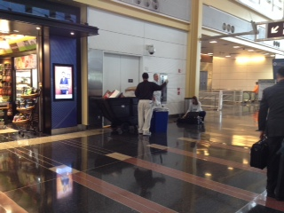
We can explore inside the terminal
If we have extra time we can explore the terminal
There are lots of things to see inside the terminal
If we want to take a break and sit we can

Slide 17
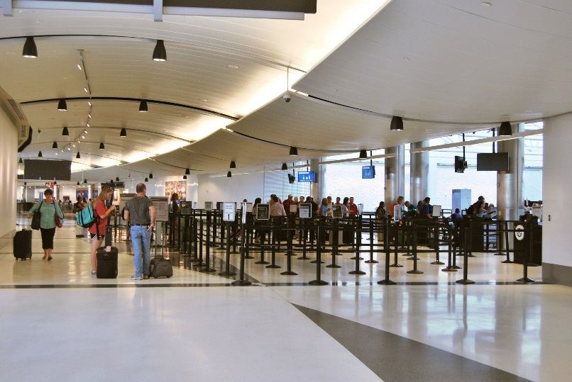
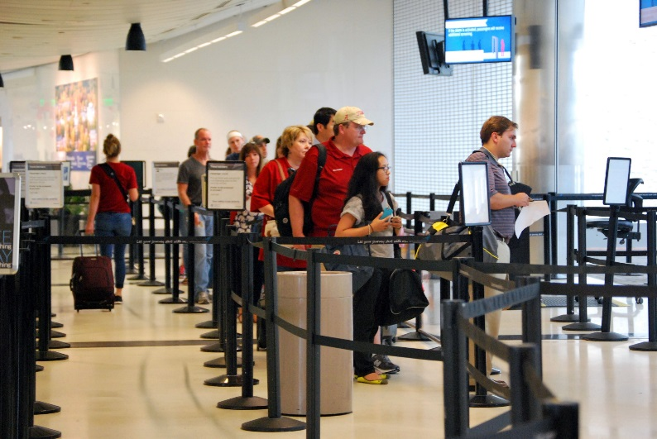
After looking around it will be time to get in line and go through security
The line may be very long
There may be a lot of people on line with us
We may have to be very patient

Slide 18
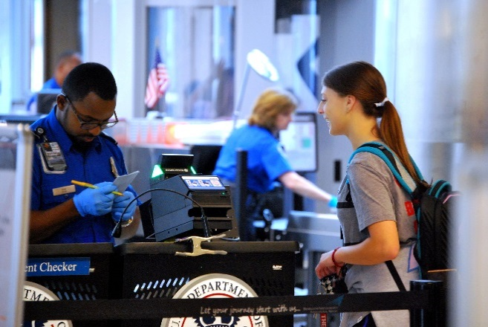
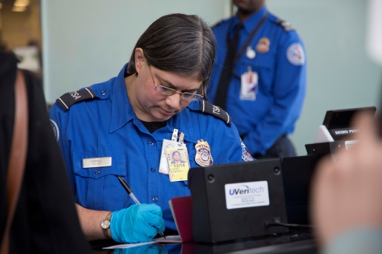
We’ll follow the Transportation Security Administration Officer’s (TSA) Instructions
The Officer will ask for our boarding pass and identification
The Officer will write on our boarding pass that it’s OK for us to pass through security
Photos used with permission from the Transportation Security Administration, Office of Strategic Communications & Public Affairs. Photo by Tara Parekh

Slide 19
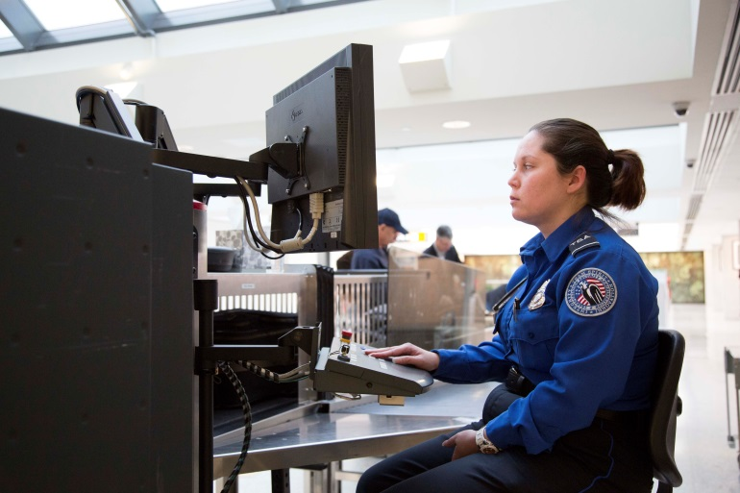
We’ll follow the TSA Officer’s Instructions
Once we give the Officer our boarding pass and identification we’ll wait in the next line
The line may be very long
There may be a lot of people on line with us
We may have to be very patient
We’ll see lots of Officers and equipment
Photo used with permission from the Transportation Security Administration, Office of Strategic Communications & Public Affairs. Photo by Tara Parekh

Slide 20
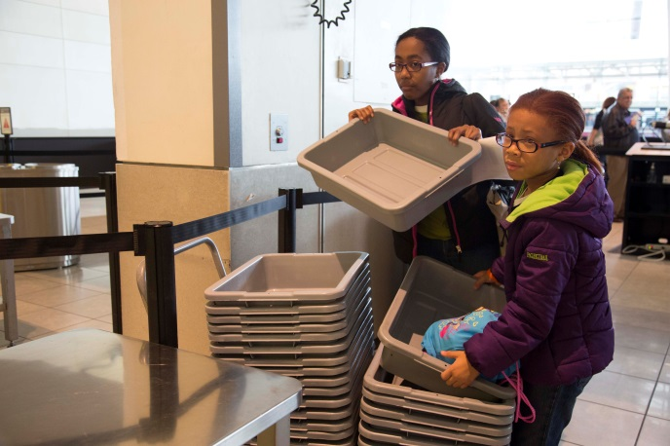
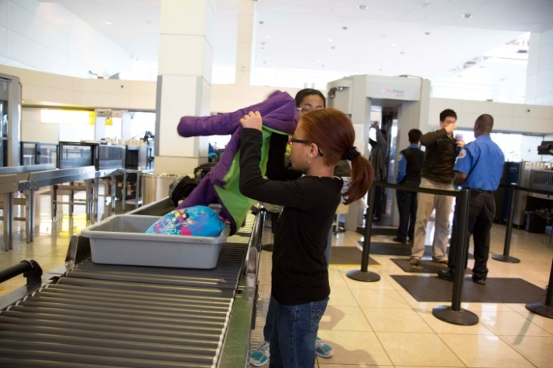
We’ll follow the TSA Officer Instructions
Pick up a plastic bin
Remove our shoes (people over age 12)
Remove our coats
Remove metal and electronics from our pockets (including belts)
Place them in a gray bin
Put the bin on the conveyor belt

Slide 21
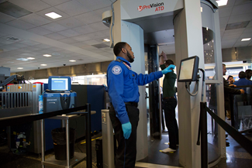
We’ll follow the TSA Officer’s instructions
Walk up to the X-ray machine
Wait for the Officer to tell us to walk through
Walk through slowly
Depending on the type of machine we may have to stop and raise our hands while they take an X-ray
Wait for the Officer to read the X-ray
Photos used with permission from the Transportation Security Administration, Office of Strategic Communications & Public Affairs. Photo by Tara Parekh

Slide 22
We’ll follow the TSA Officer’s instructions
Some people are a little afraid to walk through the X-ray machine by themselves
We can take our time
One of us can go through first and wait for you to go through
The Officer won’t do anything that hurts
Officers are very nice people whose job is to keep us safe
Photo used with permission from the Transportation Security Administration, Office of Strategic Communications & Public Affairs. Photo by Tara Parekh

Slide 23
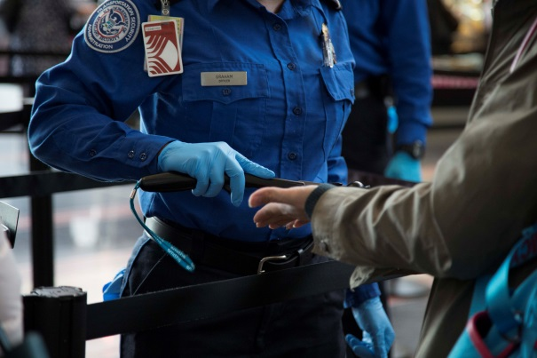
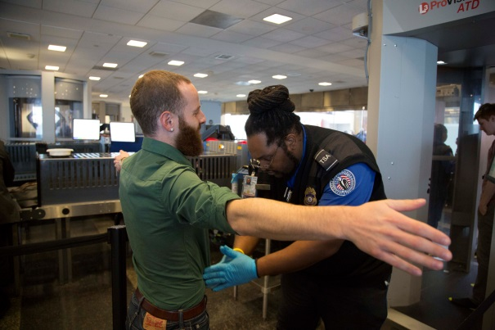
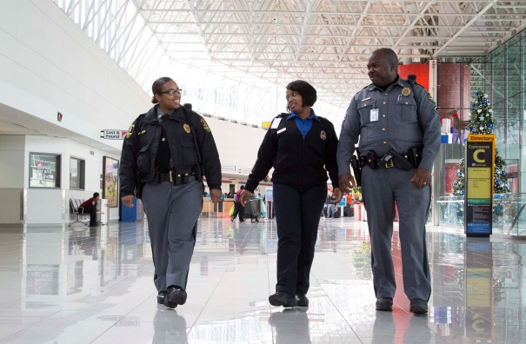
Sometimes TSA Officers do additional screening
Officers may wave a wand over our hands or body
Officers may make sure we don’t have anything under baggy clothing
The Officer won’t do anything that hurts
Officers are very nice people whose job is to keep us safe
Photos used with permission from the Transportation Security Administration, Office of Strategic Communications & Public Affairs. Photo by Tara Parekh

Slide 24
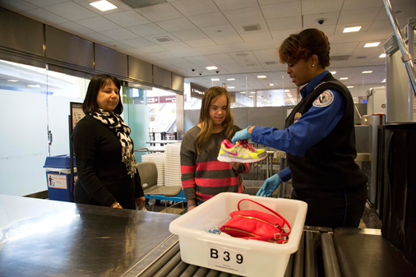
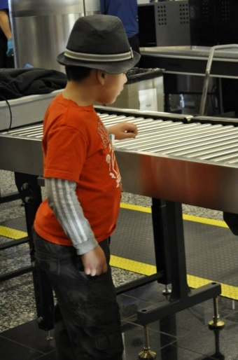
Our last step is to pick up our belongings
Get our items from the plastic bin
Walk/roll to a chair
Put our shoes and coats back on
Photos used with permission from the Transportation Security Administration, Office of Strategic Communications & Public Affairs. Photo by Tara Parekh

Slide 25
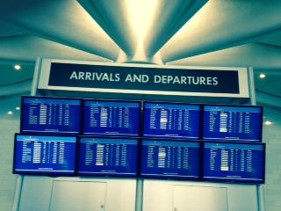
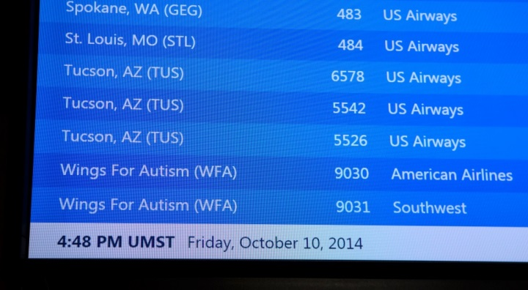
Let’s see if our practice flight is on the departure screen
Is our practice flight on the screen?
Look for the flight number and gate
Our practice flight may not be posted
When we take a real flight information will be posted
Photo by An Pham

Slide 26
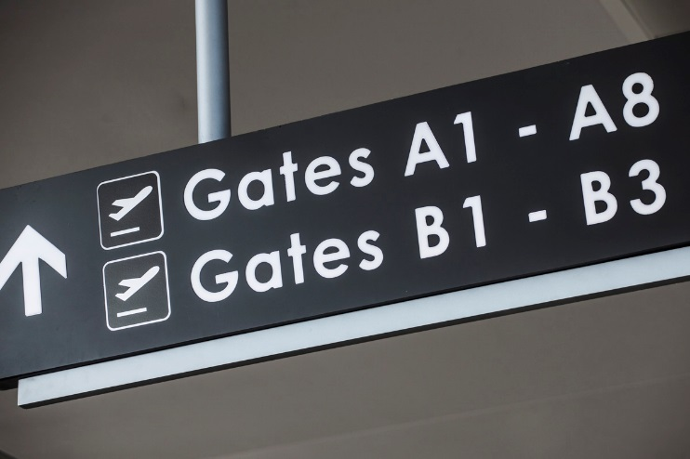
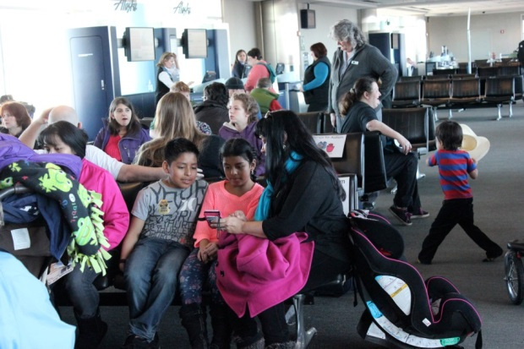
Our next step is to go to our gate and wait for our plane
There will be a lot of people waiting at our gate
We may have to be very patient
We can use any toys, games, or snacks we packed in our carry-on luggage if we want

Slide 27
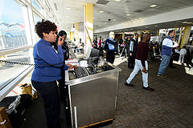
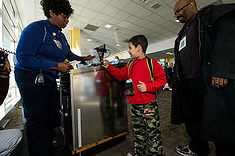
When the flight crew is ready we’ll hear the announcement to board the plane
We’ll put back anything we took out of our carry-on luggage
We’ll get our boarding pass
And we’ll get on line
The line will be very long
There will be a lot of people on line with us
We may have to be very patient
Photos by Will Schermerhorn

Slide 28
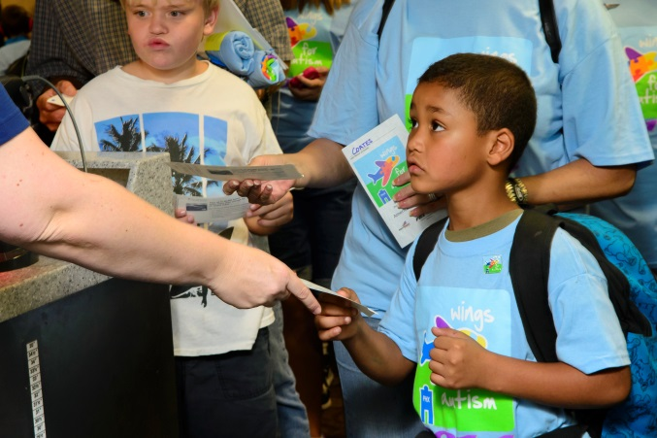
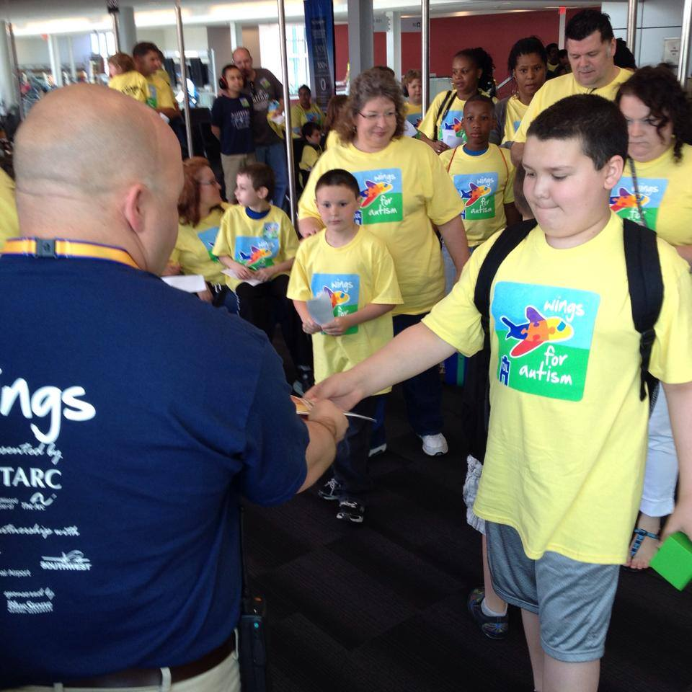
Give our boarding pass to the Gate Agent
The Gate Agent will take our boarding pass
She or he will place it in a machine
The machine will read our boarding pass and make a beeping sound
We may or may not get the boarding pass back
The Gate Agent will tell us to board the plane
Photo by An Pham

Slide 29
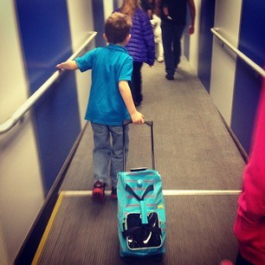
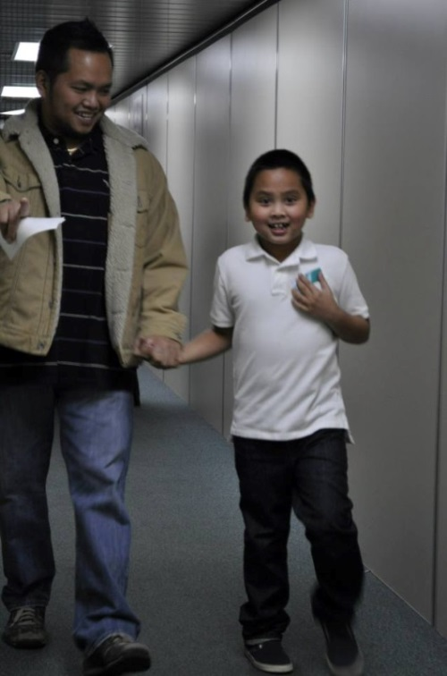
Then we’ll walk down the jetway
A jetway is a hallway that connects the airport and the airplane
We’ll get in line
The line may be very long
There will be a lot of people on line with us
We may have to be very patient
Some people are a little afraid to walk down the jetway
We can take our time and walk together

Slide 30
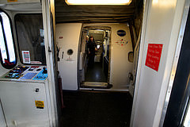
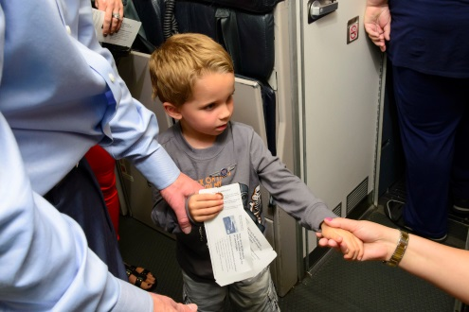
And now we’re ready to board the airplane
We’ll see a small gap between the jetway and the plane
Some people are a little afraid of the gap
We can take our time and walk into the plane together
Once we’re on the plane we’ll meet the Pilots and Flight Attendants
The airport and airline employees are volunteering their time today and are very happy to see us
Let’s make sure to give them a big thank you!!
Photo by Will Schermerhorn
Photo by An Pham

Slide 31
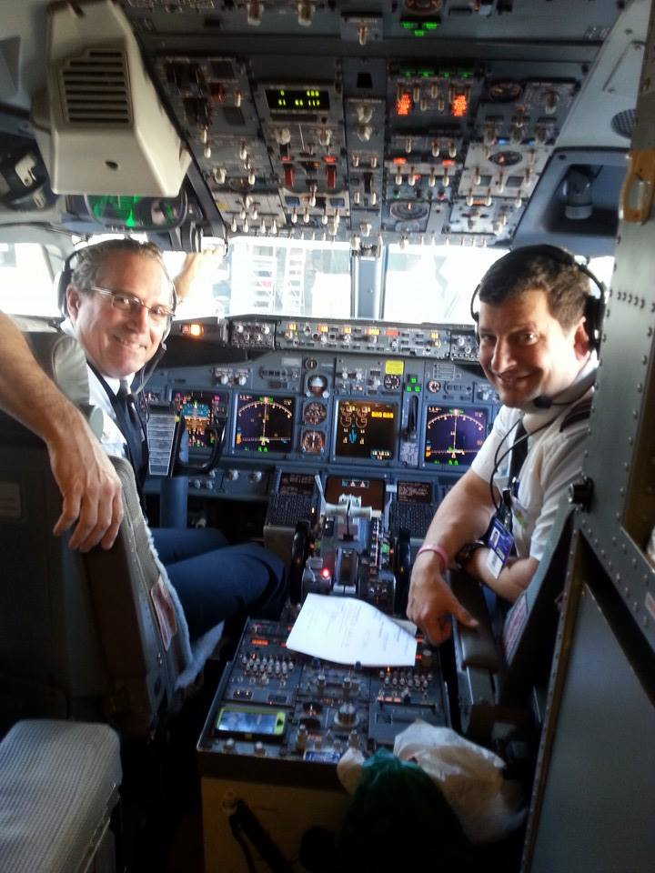
We may have time to look around the airplane
But only if the Flight Attendants say it’s OK
And only if there is time
If it’s OK and we have time we can look at the seats, the restrooms, and the overhead storage bins
If the cockpit door is open we can look inside
Photo by An Pham

Slide 32
The Flight Attendants will tell us to store our luggage
We can place our carry-on bags in the overhead bin
Or we can place our carry-on bags under the seat in front of us
In a real fight all carry-on bags must be stored during take-off and landing
Photo by Will Schermerhorn

Slide 33
The Flight Attendants will tell us to find our seats
The Flight Attendants will use a Public Address system to make announcements
They’ll tell us when it’s time to find our seats and fasten our seatbelts

Slide 34
We’ll hear lots of sounds on the airplane
The announcements and sounds may be very loud
We’ll hear bells
We’ll hear people talking
We may hear the airplane door close
We are allowed to wear noise cancelling headphones if we want to
We are not allowed to wear headphones attached to electronic devices
Photo by An Pham

Slide 35
We’ll experience other things in the airplane environment
We may feel cold or hot air coming from the vents
The lights may go on and off
The airplane will be crowded
The seats may be small and have little legroom
The Flight Attendants may wheel a cart down the aisle
This practice is your to get used to these unfamiliar things

Slide 36
The Flight Attendants will tell us to fasten our seatbelts
Just like when we’re in a car we must fasten our seatbelts on an airplane
This is to ensure our safety
Photos by Will Schermerhorn

Slide 37
We’ll have time to look around our seat
We can open and close the window shade
We can look outside the window
We can open and close the tray table
We can look at the magazines in the seatback pocket
There may even be a TV for us to watch
Photos by Will Schermerhorn

Slide 38
The Flight Attendants will give us several safety announcements
We’ll learn about oxygen masks
We’ll learn about safety vests
We’ll learn about the lights on the floor
We’ll be told where to find the restrooms
It’s our job to listen careful and be quiet so everyone can hear the announcements
Photos by Will Schermerhorn

Slide 39
If we want we can take lots of pictures to remember today’s experience
Pictures of the airplane
Picture of the Pilots and Flight Attendants
Pictures of other people
Pictures of us!
We can post our photos on social media using the guide we receive from The Arc
We can add them to this guide and review them when we take a real trip
Photo by An Pham

Slide 40
We’ll be on the plane for a little while
We won’t be flying today, this is a practice
The plane will probably stay at the gate
The Flight Attendants may announce that we can take things out of our carry-on luggage
Now it’s time to play with toys, games, books we brought from home if we want to
We can also enjoy the snack we brought from home if we want to

Slide 41
The Flight Attendants will tell us when it’s time to get ready to leave the plane
Put away our belongings
Store our carry-on luggage
Fasten our seatbelts
Place our seat in the upright position
Close our tray tables
The Flight Attendants may collect any trash from us. If they don’t we’ll remove it from the plane ourselves

Slide 42
The Flight Attendants will tell us when our practice airplane trip is finished
We’ll be told to unfasten our seatbelts
Check the overhead bin
Check the under the seat in front of us
Check the seatback pocket
Collect everything we brought from home
Leave the airplane

Slide 43
Then we’ll walk back down the jetway again
Remember, we’ll be in a line
The line may be very long
There will be a lot of people on line with us
We may have to be very patient

Slide 44
And get off the plane
Then we’ll be back in the airport
And ready for the next step
We should remember that the airport can be noisy and crowded
Photo by Will Schermerhorn

Slide 45
Some of the events have a reception
Photo by An Pham
Photo by An Pham
We may hear a short welcome speech. We may have refreshments
The room will be crowded and people will be talking

Slide 46
The reception gives us the chance to meet people who hosted the event and thank them for this experience
Photo by An Pham

Slide 47
And then we’ll be finished with our practice
Gather our belongings and get ready to leave the airport
Walk through the airport terminal
Find our car, bus or train station, taxi stand or ferry terminal
And go home
Photo by An Pham

Slide 48
And finally, we can discuss our experience
What did we like about the airport?
What did we like about the airplane?
Is there anything that made us feel uncomfortable?
Is there anything we want to do the next time we’re at the airport and on an airplane?
Photo by An Pham

